Slide 1
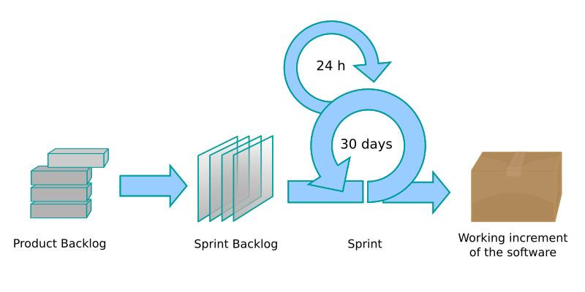
Scrum-Agile Methodology
How it works and is it worth it?
Mac Grier
Image Credit: Lakeworks(OCAL)

Slide 2


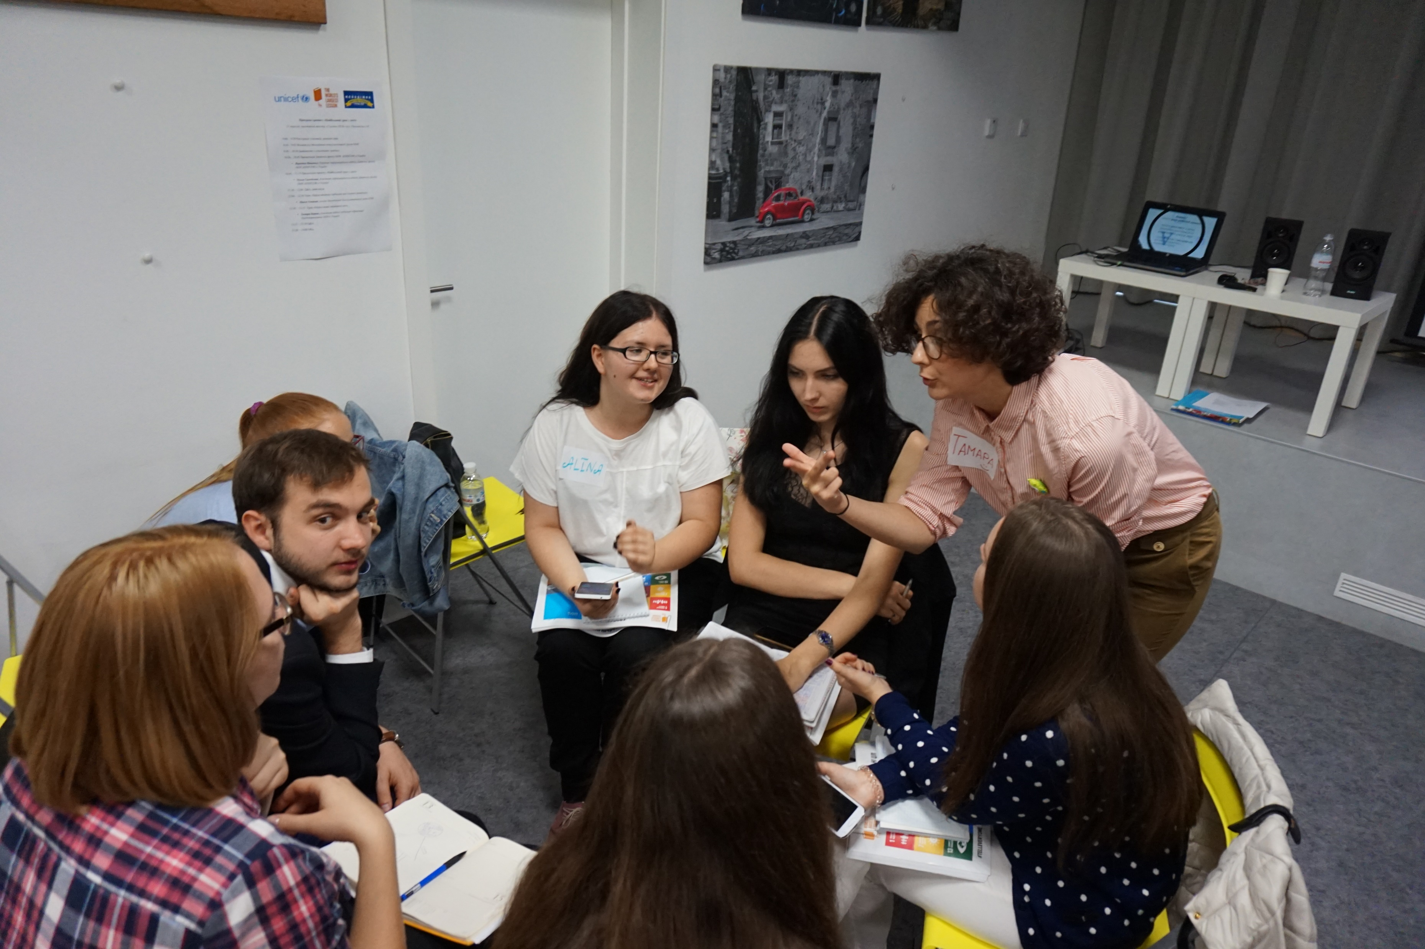
Roles in Agile
Product Owner
Scrum Master
Developer
Tester
Stakeholders
Image Credit: UNICEF Ukraine from Kyiv, Ukraine

Slide 3
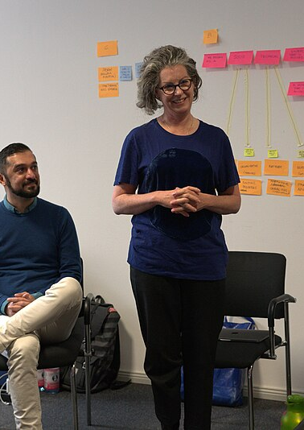
Product Owner
Manages the product vision
Curates and prioritizes backlog of user stories
Facilitates communication with stakeholders
Helps team with planning for upcoming sprints
Reviews team’s progress
(Magistretti, S., & Trabucchi, D. (2024), Alami, A., & Krancher, O. (2022))
Image Credit: Abbad(WMF)

Slide 4
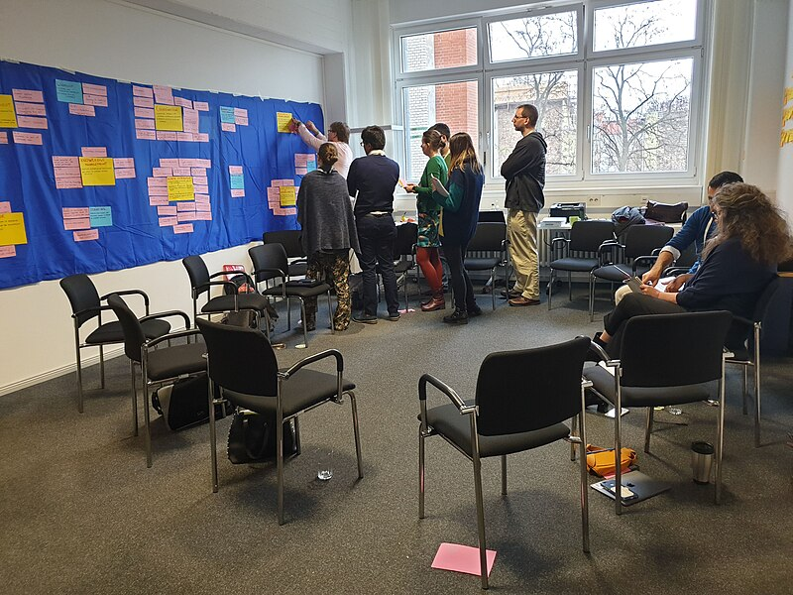
Scrum Master
Organizes and moderates daily stand-ups and other scrum events
Identifies progress blocking issues and works to remove them
Encourages team members to collaborate with each other
Ensures team understands importance of Agile methodology
(Magistretti, S., & Trabucchi, D. (2024), Alami, A., & Krancher, O. (2022))
Image Credit: Abbad(WMF)

Slide 5

Developer
Works on user stories developing product features
Communicates estimates of work to help sprint planning
Collaborates with other team members to work through problems together
Works with testers to create test cases
(Magistretti, S., & Trabucchi, D. (2024), Alami, A., & Krancher, O. (2022))
Image Credit: Daudi Mukiibi

Slide 6
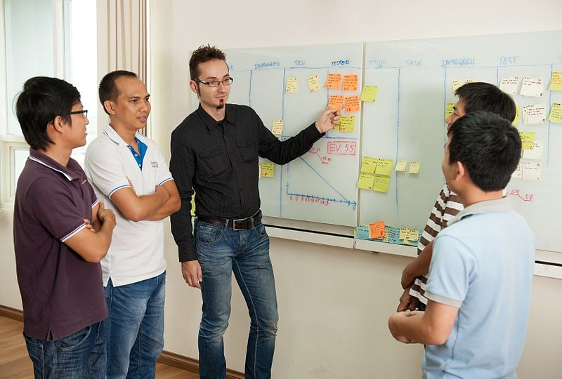
TESTER
Creates test cases
Executes tests manually or automatically
Collaborates with developers to find issues and verify fixes
Reviews user stories
Ensures smoother user experience
(Magistretti, S., & Trabucchi, D. (2024), Alami, A., & Krancher, O. (2022))
Image Credit: Nghungdo

Slide 7
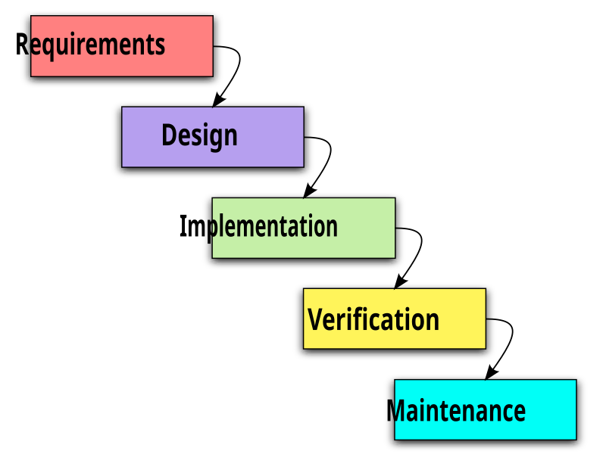
Waterfall development methodology
Gather all requirements before development
Design and plan code architecture
Implement plan with coding and software development
Test for bugs and other issues
Support product post release
Petersen, K., Wohlin, C., Baca, D. (2009)
Image Credit: Paul Smith/Paulsmith99 en.wikipedia.org

Slide 8
Potential issues working with waterfall
Requirements for the product are fixed at the start of development, change would require a full replanning of the project
Phases of Waterfall would be entirely worthless since they would have to be repeated
Team members would be discouraged by the discarding of code, development time, and large amounts of documentation
SNHU Travel’s requirements from stakeholders changed during development. Here are some potential issues that could have arisen if we had used the Waterfall methodology.

Slide 9
Pros and cons of each development method
Agile
waterfall
Iterative cyclical development
Flexible to feedback
Focus on working product over documentation
Continuous improvement through review
Linear plan-based development
Fixed requirements
Heavy documentation
Distinct phases for each project step

Slide 10
References
Verwijs, C., & Russo, D. (2023). A theory of scrum team effectiveness. ACM Transactions on Software Engineering and Methodology, 32(3), 1–51. https://doi.org/10.1145/3571849
Alami, A., & Krancher, O. (2022). How Scrum adds value to achieving software quality. Empirical software engineering, 27(7), 165. https://doi.org/10.1007/s10664-022-10208-4
Magistretti, S., & Trabucchi, D. (2024). Agile-as-a-tool and agile-as-a-culture: A comprehensive review of agile approaches adopting contingency and configuration theories. Review of Managerial Science. https://doi.org/10.1007/s11846-024- 00745-1
Petersen, K., Wohlin, C., Baca, D. (2009). The Waterfall Model in Large-Scale Development. In: Bomarius, F., Oivo, M., Jaring, P., Abrahamsson, P. (eds) Product-Focused Software Process Improvement. PROFES 2009. Lecture Notes in Business Information Processing, vol 32. Springer, Berlin, Heidelberg. https://doi.org/10.1007/978-3-642-02152-7_29

